Slide 1


Slide 2



Building High Performance Systems with Akka.Streams
By Aaron Stannard, Founder of Akka.NET / CEO Petabridge

Slide 3
Akka.Streams: LINQ-like Async Streams
var actorSystem = ActorSystem.Create("AkkaStreams", @"akka.loglevel = DEBUG"); var materializer = actorSystem.Materializer(); // create server Source<Dsl.Tcp.IncomingConnection, Task<Dsl.Tcp.ServerBinding>> connections = actorSystem.TcpStream().Bind("127.0.0.1", 8888); var (serverBind, source) = connections.PreMaterialize(materializer); // server event handler - per connection source.RunForeach(conn => { var echo = Flow.Create<ByteString>() .Via(Decoder) .Select(c => c.ToString()) .Select(c => { return c.ToUpperInvariant(); }) .Select(ByteString.FromString) .Via(Encoder) .GroupedWithin(100, TimeSpan.FromMilliseconds(20)) .Select(x => x.Aggregate(ByteString.Empty, (s, byteString) => s.Concat(byteString))); conn.HandleWith(echo, materializer); }, materializer); await serverBind;

Slide 4
Demo
https://github.com/Aaronontheweb/Akka.Streams.Benchmark

Slide 5
Significant Changes in Performance Possible Through Low Code
var repeater = ByteString.FromString("A"); var dataGenerator = Source.Repeat(repeater) .Via(Encoder) .Batch(100, s => s, (s, byteString) => s.Concat(byteString));
Batching 100 messages per socket write with this line added.
Boosts performance to 312,000 msg/s

Slide 6
Alpakka: Akka.Streams Integrations
Akka.Peristence.Query
Azure EventHubs, Service Bus, Queues
Kafka
AMQP 0.9 / 1.0 (RabbitMQ)
SignalR
AWS Kinesis, SQS, SNS
CSV / XML Files
Coming Soon: gRPC

Slide 7
Why Use Akka.Streams?
Use Cases and More

Slide 8
You Have Streaming Problems
This is problem in most async producer-consumer systems.

Slide 9
You Have Streaming Problems
Caused by await-s accumulating faster than they can be completed.
Eventually the slower consumer will begin failing requests if not managed.
Akka.Streams can help you manage that through “backpressure” signals sent upstream.

Slide 10
Solution: Reactive Streams
Solution:
Allow slower consumers to signal “I’m too busy” to producers and
Program producers to handle the “backoff” signal by pausing, compressing, or aggregating work until consumer is ready again.

Slide 11
Akka.Streams: .NET Reference Implementation of Reactive Streams
Uses a “pull” model to send backoff signals
Pull request == give me N messages
Each successful message processed downstream → demand more from upstream
When demand stops, due to busyness, upstream goes into “backoff”
This makes the entire stream capable of load-balancing itself
Built on top of Akka.NET actors

Slide 12
Solving Streaming Problems
Only batches requests once DB can’t keep up
DB Queries execute here
Notes:
The key to making this reactive is that we don’t batch by default, which is preferable because we want our interactions with the database to be atomic and isolated. However, if it’s a choice between being unavailable + compromising those isolation guarantees, many developers will choose the latter. Reactive.Streams strikes a balance such that we don’t have to break those isolation guarantees unless the backpressure from the database doesn’t offer us any choice.

Slide 13
Lots of Useful, Reusable Stages
Combine<T> - merge several sources together
GroupedWithin<T> - debounce events in groups of N or within T milliseconds
Batch<T> - group elements together when downstream is too busy
Select<TIn,TOut> - project from one type to another
Where<T> - filter out elements based on predicate
Broadcast<T> - broadcast stream elements to multiple consumers
Throttle<T> - delay the rate at which elements can be passed downstream

Slide 14
Materialized Values Integrate Akka.Streams in More Places
Some Akka.Streams stages expose different materialized values you can use to interact with the graph:
Source.ActorRef → IActorRef
Source.Queue<T> → IQueue<T>
Sink.Seq<T> → IImmutableList<T>
Sink.RunForEach<T> → Task<T>
Sink.AsyncEnumerable<T> → IAsyncEnumerable<T>
These can be passed around to other parts of your application.

Slide 15
Demo
https://github.com/Aaronontheweb/Akka.Streams.KafkaDemo

Slide 16
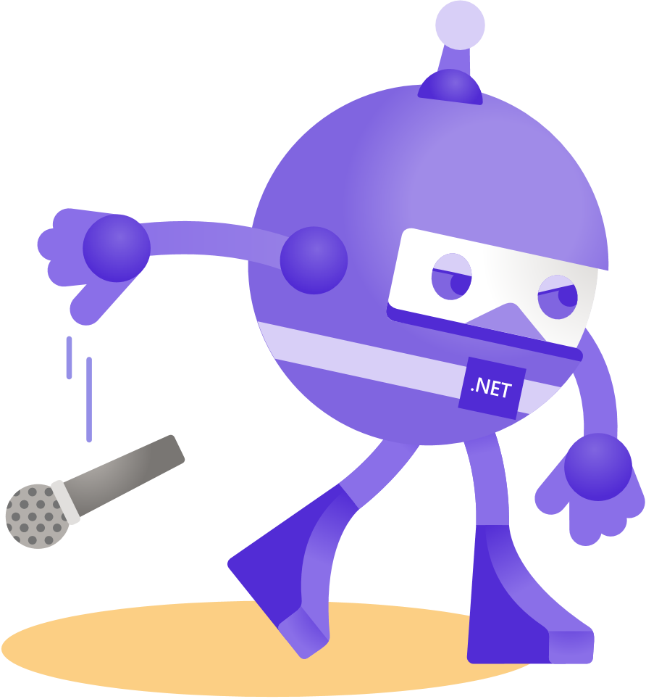
Thanks for joining!
Learn more:
https://tinyurl.com/akkastreams
https://petabridge.com/bootcamp/

